Slide 1
Antibiotic Stewardship and the
Misdiagnosis of UTI
Daniel J. Pallin, MD, MPH
Director of Research, Department of Emergency Medicine
Chairman, Clinical Investigation Committee
Brigham and Women’s Hospital
Assistant Professor, Medicine and Pediatrics
Harvard Medical School
12/10/2012

Slide 2
Under normal conditions…
2
the skin surface is not sterile…
the mouth is not sterile…
the colon is not sterile…
and in many patients,
the bladder is not sterile.

Slide 3
3
Asymptomatic Bacteriuria
the culture is positive
but no infection is present
Positive culture is:
  ≥10⁵ CFU (midstream clean-catch)
  or
  ≥10² CFU (cath)

Slide 4
Asymptomatic Bacteriuria
4
Positive urine culture, but
no need for antibiotic treatment
  Exceptions:
  Pregnancy
  Urological surgery

Slide 5
Infectious Diseases Society of America Guidelines
5
Strength of Recommendation
Strongest recommendation in favor
Recommend in favor
Neutral
Recommend against
Strongest recommendation against

Slide 6
Infectious Diseases Society of America Guidelines
6
Type of evidence
Randomized clinical trials
Well-controlled nonrandomized studies
Expert opinion, strong logic

Slide 7
7
7
Grade A – III example:

Slide 8
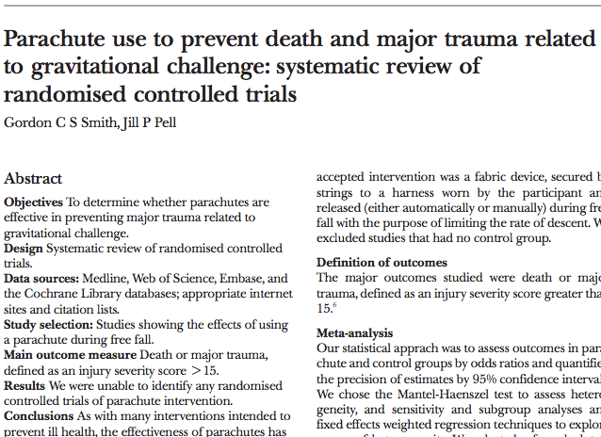
8

Slide 9
Asymptomatic Bacteriuria: “Do not test, do not treat”
9
Population | Quality
Elderly, institutionalized | A - I
Pre-menopausal, non-pregnant women | A - I
Diabetic women | A - I
Older people in the community | A - II
Notes:
IDSA 2005 ASB guidelines

Slide 10
Asymptomatic Bacteriuria
10
Population | Prevalence
Long-term care facility, age ≥70
Women | 25-50%
Men | 15-40%
Community, age ≥70
Women | 11-16%
Men | 4-19%
Healthy pre-menopausal women | 1-5%
Notes:
IDSA 2005 ASB guidelines

Slide 11
11
Therefore,
without UTI symptoms,
urine testing leads to
false diagnosis of UTI
  Unnecessary antibiotics
  Missing the real diagnosis

Slide 12
Our Goal:
Give you a new perspective on urine microbiology
  Faster care
  Lower expenses
  More accurate testing & treatment
  and fewer unnecessary antibiotics!
12

Slide 13
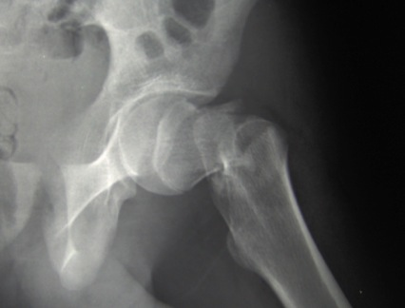
Case Vignette
13
75 year old female, “Hip pain”
Slipped on wet floor at her nursing home
Exam reveals shortened & externally rotated leg
Xray: hip fracture

Slide 14
Case Vignette
14
Tests that are done:
  CBC, Chem 7, PT/PTT, Type and Screen
  Chest xray
  EKG
  Urine dip

Slide 15
Challenges
15
Can this lady do a midstream clean-catch?
Did the clinician specify how the specimen should be collected?

Slide 16
But the real challenge is…
16
Why is the urine being tested in the first place?!

Slide 17
17
Was the urine dip ordered?
Was it done “because of her age?”
Was it done “because we always do that?”

Slide 18
Reminder
18
Population | Prevalence
Long-term care facility, age ≥70
Women | 25-50%
Men | 15-40%
Community, age ≥70
Women | 11-16%
Men | 4-19%
Healthy pre-menopausal women | 1-5%
Notes:
IDSA 2005 ASB guidelines

Slide 19
Antibiotics in long-term care
19
2/3 elderly long-term care residents receive antibiotics every year.

Slide 20
UTI
ASB
20
FPUA
How do they overlap?
Urinary tract infection
Asymptomatic bacteriuria
False-positive urinalysis

Slide 21
Overlapping Sets
21
When symptoms are absent:
  “Positive” urine dip is meaningless.
  “Positive” urinalysis is meaningless.
  “Positive” urine culture is just ASB.
When symptoms are present:
  Only urine culture can rule out UTI.
Regardless of symptoms:
  Poor urine collection technique causes false-positive urinalysis.

Slide 22
How can we function with such uncertainty?
22
Clinical judgment
Communication

Slide 23
conceptual framework:
Spectrum of Appropriateness for urine testing & treatment
23
Notes:
http://es.wikipedia.org/wiki/Archivo:Cdm_hip_fracture_343.jpg
http://www.google.com/imgres?q=weak+and+dizzy&hl=en&rls=com.microsoft:en-us:IE-Address&biw=1536&bih=768&tbm=isch&tbnid=2w6CwhCd_zK3YM:&imgrefurl=http://www.yourerdoc.com/weak-and-dizzy-symptoms/&docid=V82LcHajMX-aYM&imgurl=http://www.yourerdoc.com/wp-content/uploads/2008/12/dizzy-senior.bmp&w=508&h=404&ei=q99pUMbtKobz0gHrvoGwDw&zoom=1&iact=hc&vpx=178&vpy=147&dur=106&hovh=200&hovw=252&tx=86&ty=147&sig=104879576637721244085&page=1&tbnh=139&tbnw=172&start=0&ndsp=34&ved=1t:429,r:0,s:0,i:70
http://bestdiytips.blogspot.com/2011/03/what-causes-painful-urination.html

Slide 24
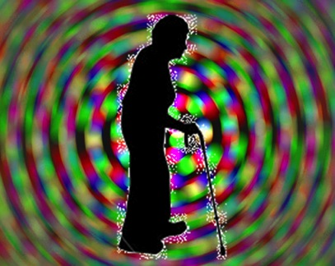

Spectrum of Appropriateness
http://www.yourerdoc.com/weak-and-dizzy-symptoms/
http://bestdiytips.blogspot.com/2011/03/what-causes-painful-urination.html
http://www.yourerdoc.com/weak-and-dizzy-symptoms/
http://bestdiytips.blogspot.com/2011/03/what-causes-painful-urination.html
http://www.yourerdoc.com/weak-and-dizzy-symptoms/
http://bestdiytips.blogspot.com/2011/03/what-causes-painful-urination.html
24
no symptoms
specific symptoms
non-specific symptoms
http://www.yourerdoc.com/weak-and-dizzy-symptoms/ http://bestdiytips.blogspot.com/2011/03/what-causes-painful-urination.html

Slide 25

25
no symptoms
non-specific symptoms
specific symptoms
Notes:
http://inducedindefinitely.files.wordpress.com/2012/02/stoplight.gif?w=490

Slide 26
No symptoms
26
DO NOT TEST!
DO NOT TREAT!

Slide 27
Specific symptoms
27
Test & treat
(or just treat)

Slide 28
Non-specific symptoms
28
Individualize care

Slide 29
The Gray Zone
29
Weak and dizzy
Altered mental status
Decreased appetite
Decreased mobility
Fever without a focus

Slide 30
The Gray Zone – Evidence?
Can J Emerg Med 2007;9(2):87-92
30
Ducharme et al. studied
200 ED patients aged ≥65
100 with vague symptoms, possibly UTI
100 with no urinary symptoms

Slide 31
Study Definitions
31
Vague Symptoms | No UTI Symptoms
Confusion | Cast check
Weakness | Minor trauma
Fever without focus | etc.
(No fever allowed in “no symptoms” group.)

Slide 32
The gray zone patient probably does NOT have UTI!
(p value = 0.34)
32
 | Positive Urine Culture
No symptoms | 14%
Vague symptoms | 19%
Ducharme, Can J Emerg Med 2007;9(2):87-92

Slide 33
Loeb Criteria: Should I Treat?
33
No Chronic Cath | Chronic Cath
Acute dysuria | Any one of the following:
or
Temp ≥ 100 or 2.4ºF above baseline | Temp ≥ 100 or 2.4ºF above baseline
plus increase in any of: | Rigors
Urgency | New delirium
Frequency
Suprapubic pain
Gross hematuria
Costovertebral angle tenderness
Urinary incontinence

Slide 34
What’s not in the Loeb criteria?
34
Odor or appearance of urine
Patients without catheter
  Altered mental status
  Isolated fever
  Weakness

Slide 35
Can I defer antibiotics?
35
Communicate with the team that will care for the patient next.
  Inpatient
  Nursing home

Slide 36
Why is this important?
36
Antibiotic stewardship
Efficiency in the ED
Premature closure/patient safety

Slide 37
Antibiotic Stewardship
37
Individual patient
  C. difficile
  Other diarrhea
  Allergy
  Drug interactions
Society
  Widespread antibiotic resistance

Slide 38
Emergency physicians already in stewardship mode for:
38
Rhinitis
Viral pharyngitis
Bronchitis
Acute gastroenteritis
“Don’t just do something – stand there!”

Slide 39
Stewardship and Emergency Medicine
39
Pride in specificity, accuracy, efficiency

Slide 40
Efficiency in the ED
40
Prescriber’s bandwidth is finite.
Nurse’s time is finite.
We all need to avoid distractions.

Slide 41

Financial Implications
41
We cannot afford to spend time and money chasing red herrings.
A national priority
What could help affordability more than eliminating unnecessary costs?
Notes:
http://tvtropes.org/pmwiki/pmwiki.php/Main/RedScare

Slide 42
Premature Closure/
Patient Safety
42
UTI is blamed, while the real criminal goes free.
  Hyponatremia
  Dehydration
  Ischemia
  Medication adverse events
  Etc.

Slide 43
Premature Closure
43
As long as you are “open” to other possibilities, you have not “closed” prematurely.
In emergency medicine, diagnosis
and differential diagnosis
go hand in hand.
Good practice always requires a caveat when
a test result could be incidental.
  “True, true, and unrelated.”

Slide 44
Collection Test Characteristics
44
Suprapubic aspiration
Catheter
Midstream clean-catch
First-void non-clean-catch

Slide 45
Suprapubic aspiration
45
With ultrasound guidance, likely very safe
Highly accurate
(for the presence of bacteria only!)
Rarely done

Slide 46
Catheterization
46
In-and-out catheterization, a.k.a.
“straight cath”
Common and safe
Embarrassing and uncomfortable
Highly accurate
(for the presence of bacteria only!)
Pitfall: never culture an old catheter.

Slide 47
Midstream Clean-Catch
47
Methods vary wildly
  Textbook to textbook
  Hospital to hospital
  Nurse to nurse
  Doctor to doctor

Slide 48
Midstream Clean-Catch
48
Difficult for the elderly
  Cognitive limitations
  Short-term memory limitations
  Physical limitations

Slide 49
Midstream Clean-Catch
49
When done correctly:
  False positive: 22%
  False negative: 23%
For the presence of bacteria only!
Notes:
Reference Roberts & Hedges – need to look at some other references.

Slide 50
Midstream Clean-Catch
50
No symptoms + no pyuria = no infection
Pyuria without symptoms ≠ infection
Symptoms with negative dipstick ≠ no infection
(poor sensitivity)
Squamous epithelial cells ≠ contamination.

Slide 51
First-void non-clean-catch
51
Necessary for PCR
  Best test for gonorrhea and chlamydia
Must not have voided x 1 hour

Slide 52
Mid-stream and first-void?
52
Extremely difficult to explain & coordinate

Slide 53
Case Vignette 2
53
45 year old man has new-onset dysuria
Challenges:
  What tests?
  Collection method?
  Is urine dip accurate?
  Is urinalysis accurate?
  Is urine culture accurate?

Slide 54
What to do about collection?
54
Communication is key!
  Between RNs and prescribers
  Explain to patients what is needed
  Ask patients what they did
Always consider cath if the voided specimen is dirty

Slide 55
Gaming the system?
55
Some facilities analyze urine whenever they put in a Foley catheter.
  Want to avoid being blamed for CAUTI
Note: the consequence of such blame is limited to non-payment for the UTI (not the whole bill).

Slide 56
Gaming the system?
56
This is billing fraud if there was no genuine medical indication for testing.
This is dangerous because physicians may react by prescribing antibiotics.
These data should NOT be reported through the usual clinical reporting system when done for this reason.
At minimum, excellent communication is required as to WHY the test was done.

Slide 57
Specific Action Items re. sample collection
57
Prescribers
Nurses
Leadership

Slide 58
Sample Collection: Prescribers
58
When there are no symptoms:
Do not test, do not treat!
In the gray zone, beware premature closure!
  Consider observation.
  Focus on differential diagnosis.
  Most of these patient probably don’t have UTI.

Slide 59
Sample Collection: Nurses
59
Don’t test urine without an order
  Collect and hold
  Specify & record collection technique.
  hCG okay

Slide 60
Sample Collection: Leadership
60
Target providers:
No non-indicated orders.
Target nurses:
No non-ordered tests.
System-wide:
Separate surveillance from clinical practice.

Slide 61
General Take-Home Messages
61
Prescribers
Nurses
Leadership

Slide 62
Prescribers
62
Use the conceptual framework
Formal, written orders only
Specify collection method

Slide 63
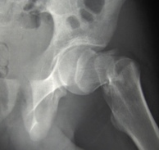


Conceptual Framework
63
No symptoms
  DO NOT TEST OR TREAT
Vague symptoms
  Beware premature closure – focus on DDx
  Consider observation instead of treatment
Specific symptoms
  Test & treat as indicated

Slide 64
Nurses and Assistants
64
Collect and hold only
Advocate for better practice: no urine testing (except hCG) without prescriber’s order
Improve communication
  What sample do we need?
  What sample did we get?

Slide 65
Leadership
65
Policies
No tests without orders
No orders without symptoms
No mixing of billing-related surveillance with clinical care
Education
Asymptomatic bacteriuria definition & prevalence
First-void vs. midstream clean-catch
(gonorrhea/chlamydia vs. traditional)

Slide 66
If we remember one thing…
66
Population | Prevalence
Long-term care facility, age ≥70
Women | 25-50%
Men | 15-40%
Community, age ≥70
Women | 11-16%
Men | 4-19%
Healthy pre-menopausal women | 1-5%
Notes:
IDSA 2005 ASB guidelines

